Slide 1


Socioeconomic Status Classification
A Data-driven Approach

Slide 2
Project Introduction
Welcome to the presentation on our project involving the Adult Census dataset.
Our project focuses on utilizing data science techniques for predictive modeling and analysis.
The Adult Census dataset is a widely used dataset in the field, offering valuable insights into socioeconomic factors affecting income levels.
Our goal is to develop robust predictive models that can accurately classify individuals based on their income levels (>50K or <=50K).
Through this presentation, we'll explore our approach, methodologies, and findings in addressing this classification task.

Slide 3
Problem Statement
The problem at hand revolves around predicting income levels based on demographic and socioeconomic features.
Specifically, we aim to classify individuals into two income categories: >50K or <=50K.
This binary classification task is crucial for various real-world applications such as targeted marketing, credit risk assessment, and social policy planning.
By leveraging the Adult Census dataset, our objective is to develop accurate predictive models that can effectively categorize individuals based on their income levels.

Slide 4
Dataset Overview
The Adult Census dataset, also known as the “Adult” dataset, is a well-known resource in machine learning and data mining.
Extracted from the 1994 Census database, it contains various demographic and socioeconomic features of individuals.
This dataset is commonly used for predictive modeling tasks, particularly in forecasting income levels based on socioeconomic attributes.
The Adult Census dataset comprises a total of 14 features, offering insights into various demographic and socioeconomic attributes. Features include both categorical and numerical variables, providing a comprehensive view of individuals' characteristics.

Slide 5
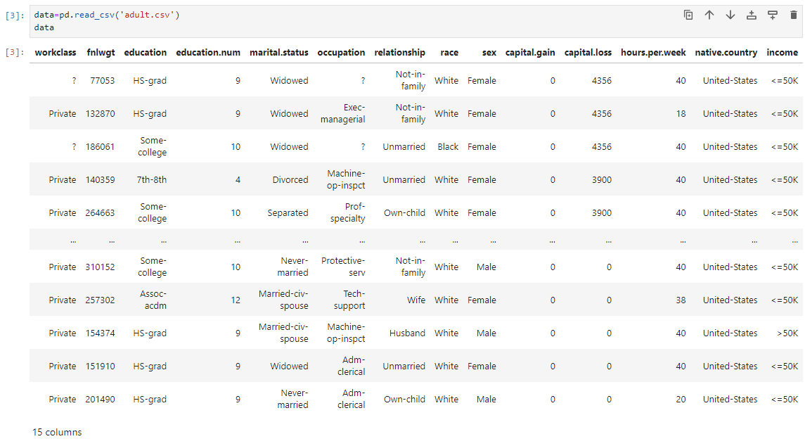
Dataset Overview

Slide 6
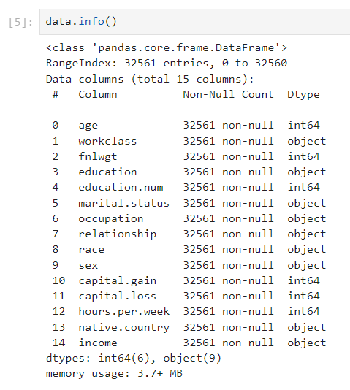
Features Overview
Categorical variables encompass attributes such as education level, occupation, marital status, race, and gender, offering insights into social and demographic factors.
Numerical variables encompass attributes such as age, education years, capital gains, capital losses, and hours per week worked, providing quantitative information about individuals’ socioeconomic status and activities.

Slide 7
EDA
Exploratory Data Analysis

Slide 8
Introduction to EDA
Exploratory Data Analysis (EDA) is a crucial step in the data analysis process, aimed at gaining insights and understanding the underlying patterns and characteristics of the dataset.
EDA involves examining various features of the dataset, visualizing distributions, assessing data balance, exploring correlations, and identifying outliers.
Through EDA, we aim to understand the structure of the data, identify potential preprocessing needs, and inform modeling decisions based on a comprehensive understanding of the dataset.

Slide 9
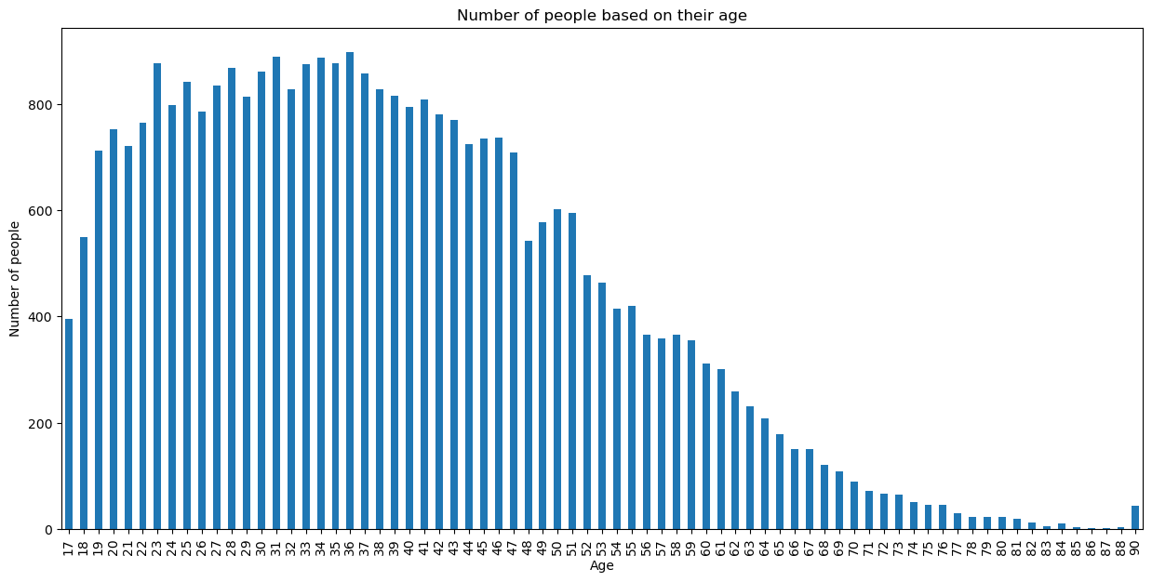
Age Distribution

Slide 10
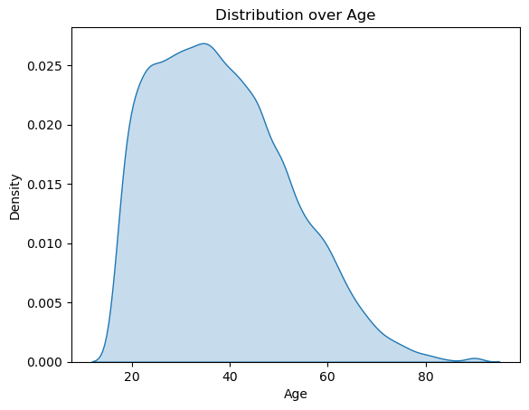
Age Distribution (KDE)

Slide 11
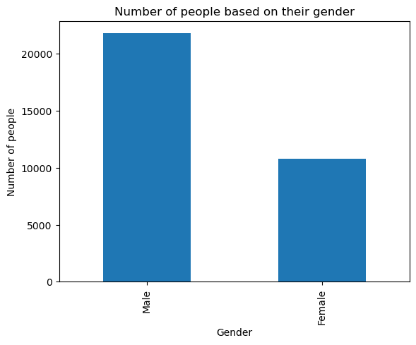
Gender Distribution

Slide 12
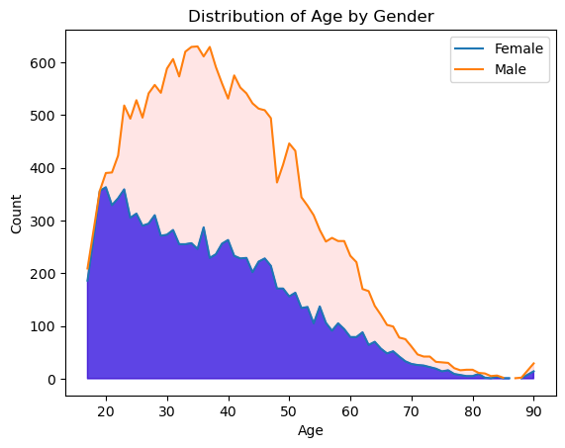
Distribution of Age by Gender

Slide 13
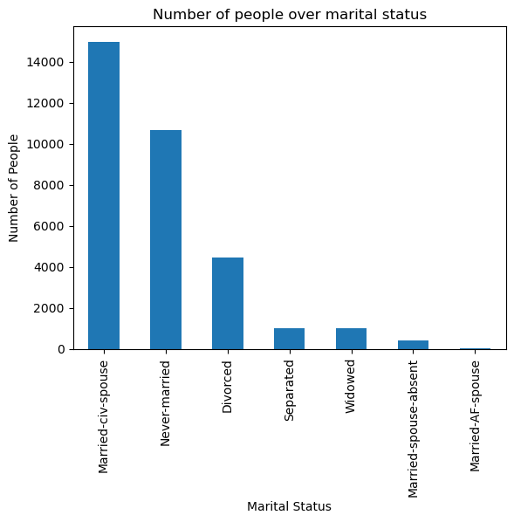
Marital Status Distribution

Slide 14
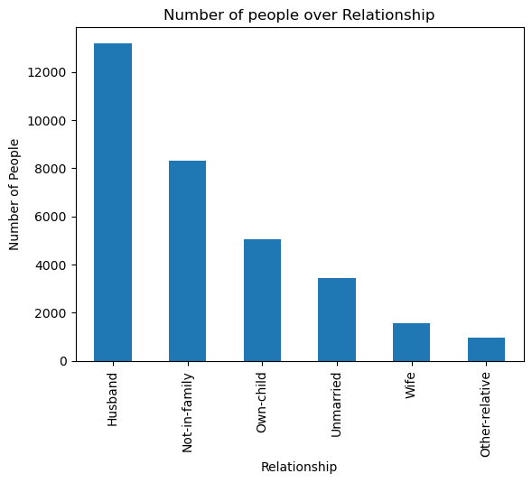
Relationship Distribution

Slide 15
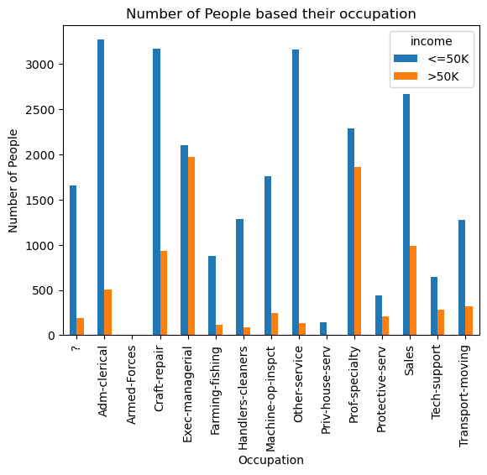
Occupation Distribution

Slide 16
Data Cleaning and Preparation

Slide 17
Data Cleaning and Preparation
Data cleaning and preparation are essential steps to ensure the quality and reliability of the dataset for analysis and modeling.
This phase involves identifying and handling missing values, encoding categorical variables, scaling numerical features, and splitting the dataset into training and testing sets.
By cleaning and preparing the data effectively, we can ensure that our models are trained on high-quality data, leading to more accurate and reliable predictions.

Slide 18
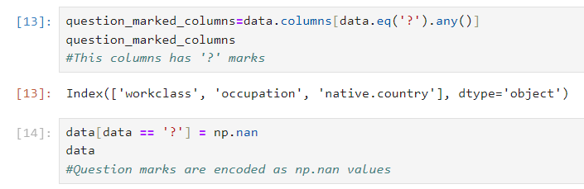
Identify Missing Values
In the Adult Census dataset, missing values are represented as “?” marks, which deviate from standard NaN values.
This non-standard representation of missing values requires special attention during data cleaning to ensure accurate analysis and modeling.
Strategies for handling missing values may include imputation, deletion, or encoding them as NaN values for consistency in analysis and modeling.

Slide 19
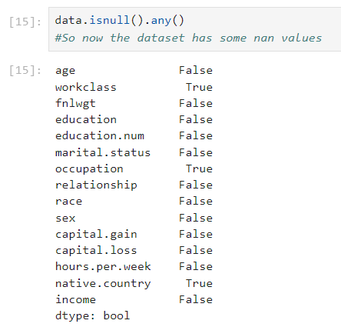
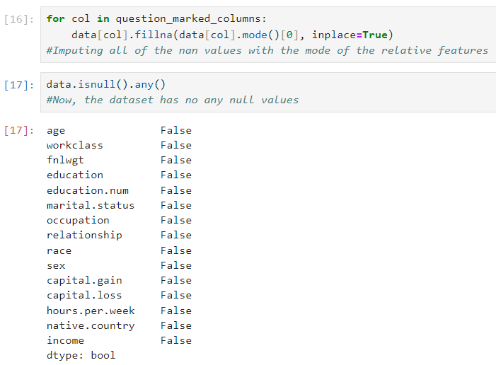
Handling Missing Values

Slide 20
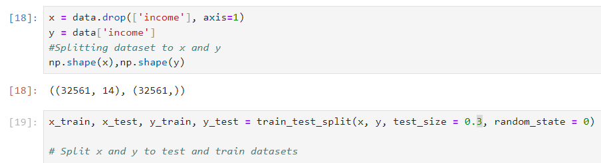
Dataset Splitting
The dataset is split into input features (x) and target variable (y).
The shape of the input features (x) is (32561, 14), while the shape of the target variable (y) is (32561,).
The dataset is further split into training and testing sets using a 70/30 ratio.
This ensures that a portion of the data is reserved for model evaluation.

Slide 21
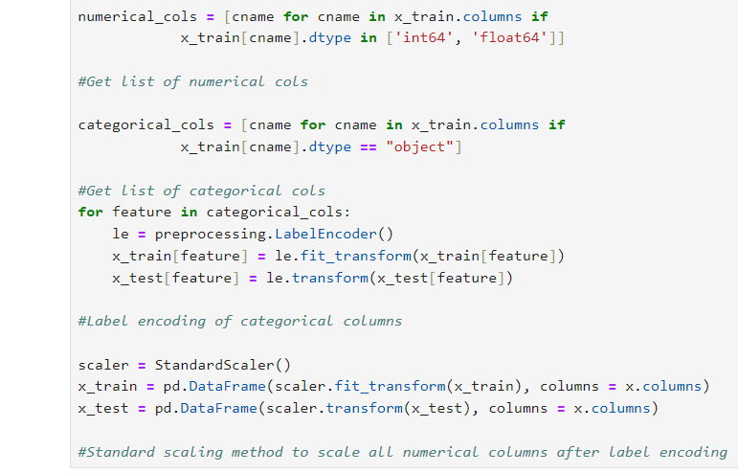
Dataset Preprocessing
Numerical and categorical columns are identified in the training set.
Categorical columns are label encoded to transform categorical values into numerical representations.
Numerical columns are standardized using StandardScaler() to ensure consistent feature scales for model training.

Slide 22
Modeling

Slide 23
Modeling Approach
Our modeling approach involves employing several machine learning algorithms to predict income levels based on demographic and socioeconomic features.
We'll explore the following steps in our modeling process:
Data preprocessing: Handling missing values, encoding categorical variables, and scaling numerical features.
Model selection: Experimenting with various algorithms such as Logistic Regression, XGBoost, and Decision Trees to identify the most suitable model for our task.
Hyperparameter tuning: Optimizing model parameters using techniques like Grid Search and Randomized Search to improve performance.
Evaluation: Assessing model performance using accuracy score.

Slide 24
Logistic Regression
Logistic Regression Experiments involve assessing the performance of the Logistic Regression algorithm in predicting income levels based on demographic and socioeconomic features.
The objective is to optimize Logistic Regression hyperparameters and evaluate its accuracy under various settings to determine its effectiveness in our predictive modeling task.
Through Logistic Regression experiments, we aim to identify the optimal configuration for maximizing predictive accuracy while ensuring model interpretability and computational efficiency.

Slide 25
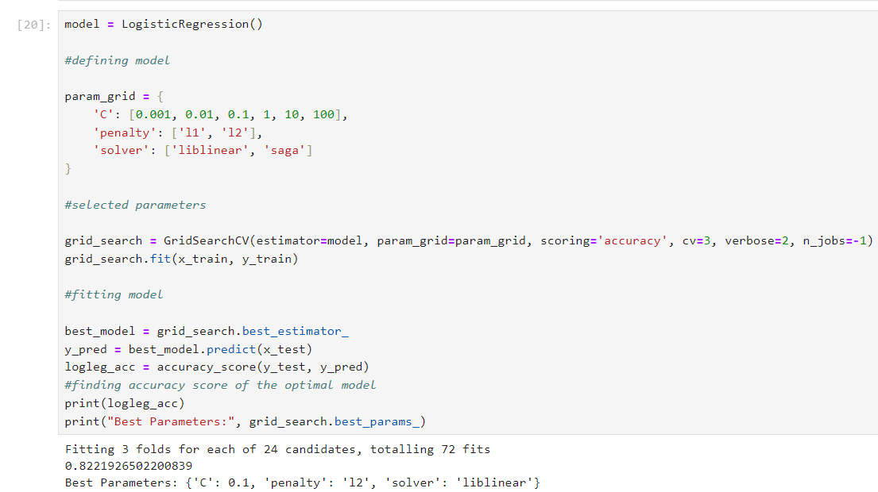
Logistic Regression in Our Approach

Slide 26
Introduction to PCA
Principal Component Analysis (PCA) is a dimensionality reduction technique used to simplify complex datasets while retaining important information.
In our experiments, we explore the impact of PCA on model performance by systematically removing features and evaluating the effects on accuracy.
The goal is to determine the optimal number of principal components that maximize predictive power while minimizing computational complexity.
Through PCA experiments, we aim to gain insights into the relationship between feature dimensionality and model performance.

Slide 27
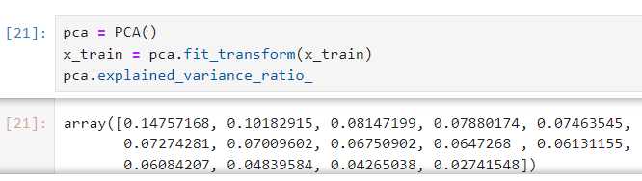
PCA Results
Experiment 1: Removing the last feature, which contributes only 2.74% to the variance, leaving 97.5% of the variance explained by the remaining features.
Experiment 2: Removing the last two features, which collectively contribute to only 7% of the variance.
Experiment 3: Removing the last three features, which contribute to only 11% of the variance.

Slide 28
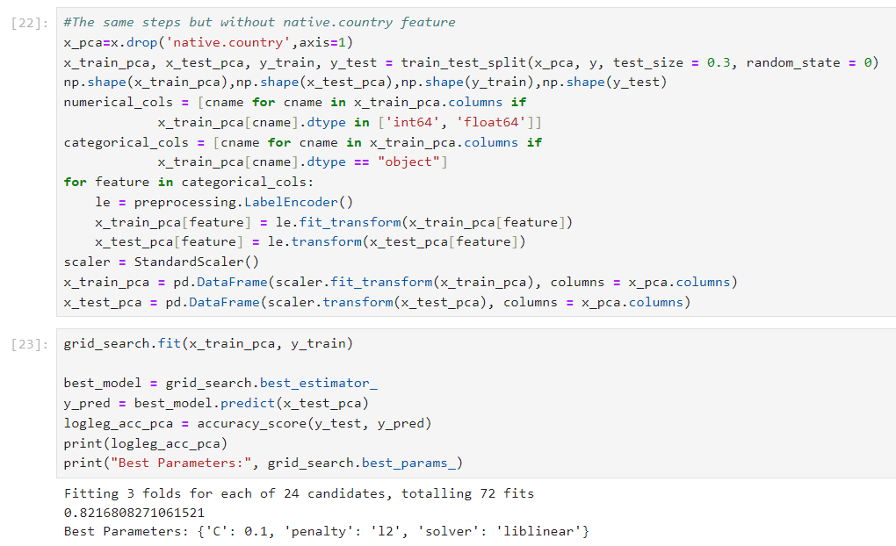
1st Experiment with PCA

Slide 29
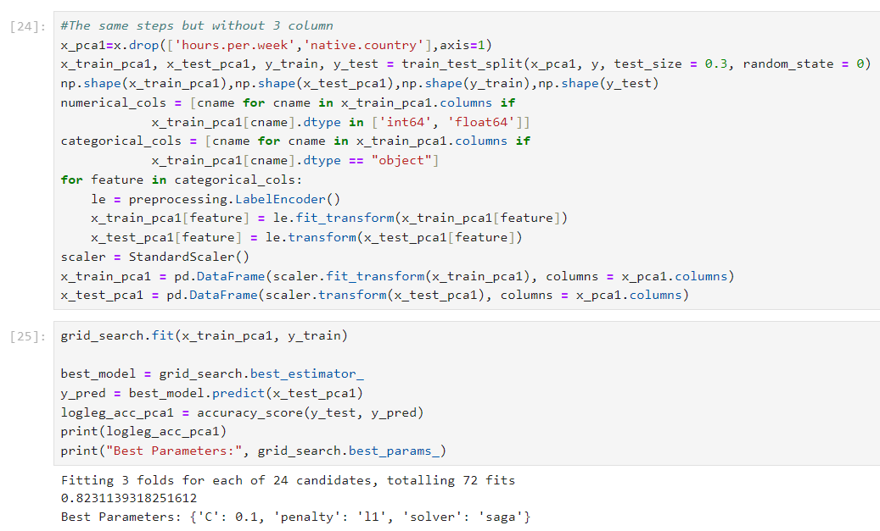
2nd Experiment with PCA

Slide 30
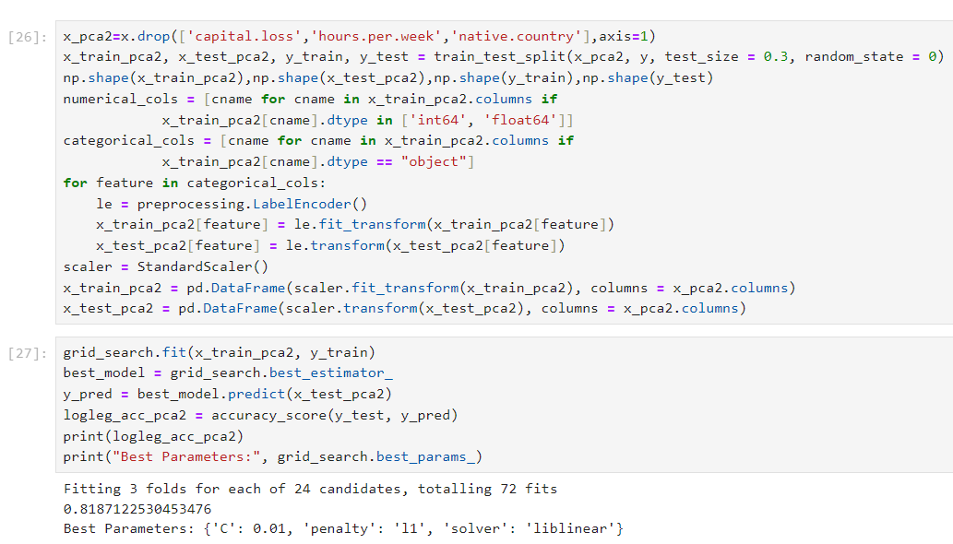
3rd Experiment with PCA

Slide 31
Introduction to XGBoost
XGBoost is a powerful gradient boosting algorithm known for its speed and performance in structured/tabular data.
In our experiments, we explore the performance of XGBoost in predicting income levels based on demographic and socioeconomic features.
We aim to optimize XGBoost hyperparameters and evaluate its accuracy in different scenarios to understand its effectiveness in our predictive modeling task.
Through XGBoost experiments, we seek to identify the best configuration for maximizing predictive accuracy while minimizing computational resources.

Slide 32
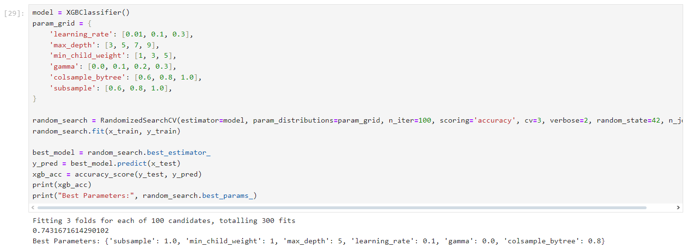
XGBoost in Our Approach

Slide 33
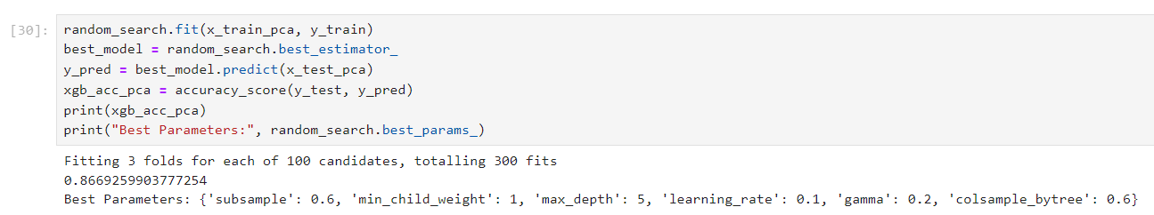
1st Experiment with XGBoost and PCA

Slide 34
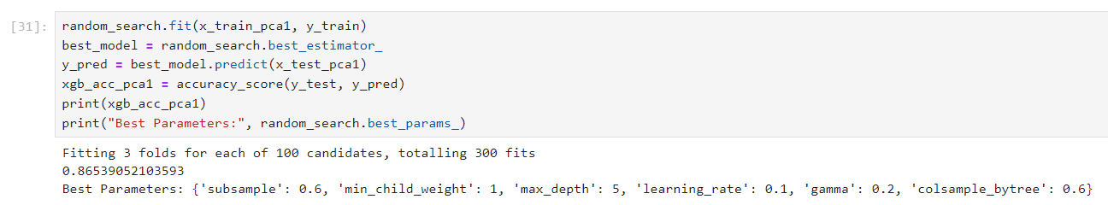
2nd Experiment with XGBoost and PCA

Slide 35
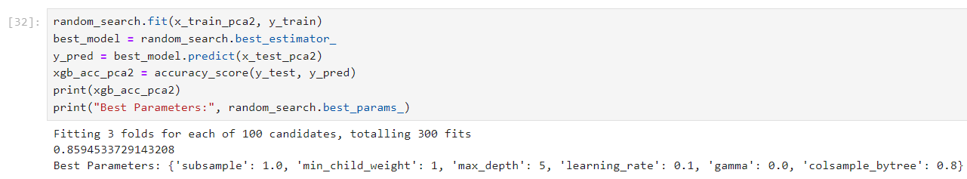
3rd Experiment with XGBoost and PCA

Slide 36
Introduction to Decision Tree
Decision Tree Experiments involve exploring the performance of the Decision Tree algorithm in predicting income levels based on demographic and socioeconomic features.
We aim to optimize Decision Tree hyperparameters and evaluate its accuracy under different configurations to understand its effectiveness in our predictive modeling task.
Through Decision Tree experiments, we seek to identify the best parameter settings for maximizing predictive accuracy while maintaining model interpretability.

Slide 37
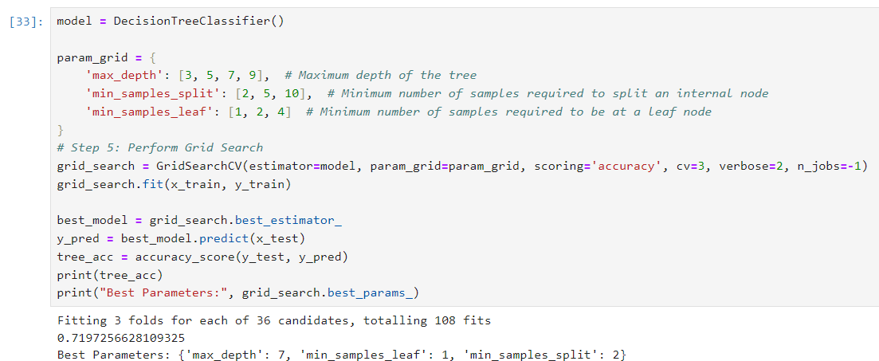
Decision Tree in Our Aproach

Slide 38
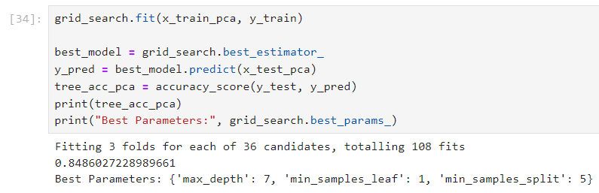
1st Experiment with Decision Tree and PCA

Slide 39
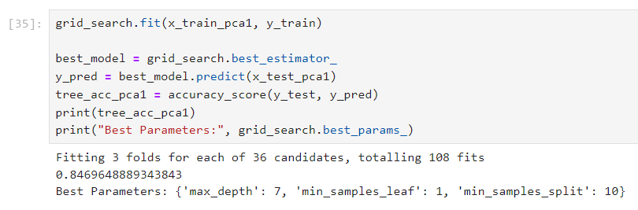
2nd Experiment with Decision Tree and PCA

Slide 40
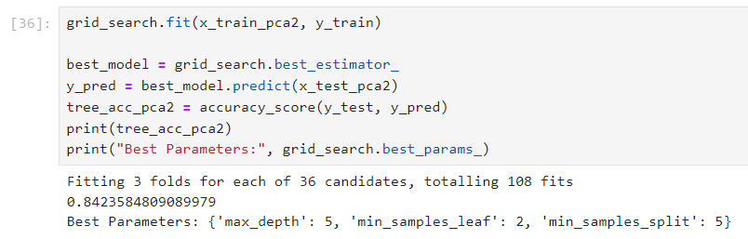
3rd Experiment with Decision Tree and PCA

Slide 41
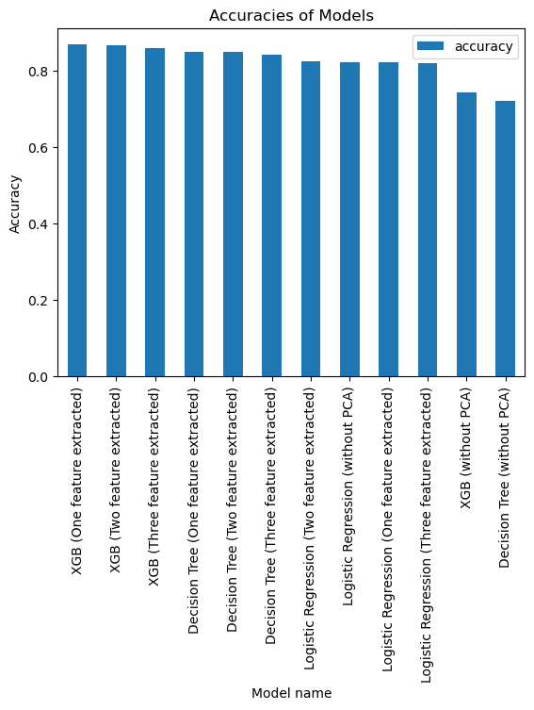
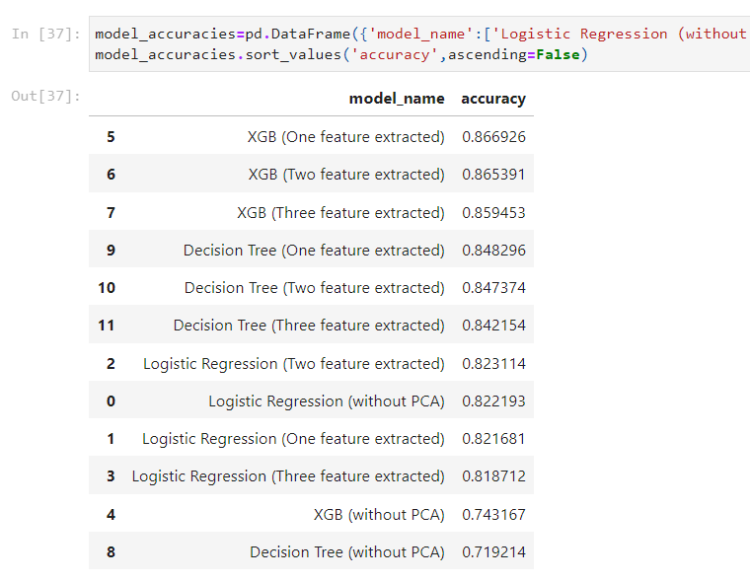
Model Accuracies

Slide 42
Conclusion
Based on our model accuracies, XGBoost with one feature extracted emerges as the top-performing model.
XGBoost demonstrates superior predictive power in classifying income levels based on demographic and socioeconomic features.
The success of XGBoost underscores the importance of feature selection and algorithm optimization in enhancing model performance.

Slide 43
Thanks for attention
For further information or improvement suggestions, please feel free to contact me at samir.guliyev@hotmail.com.

